Slide 1
Comparative Analysis of Trading Algorithms via Amazon Stock
Indrajith Senevirathne, Shishir Suman, and Sujit Subhash

Slide 2
Outline
The goal of this Study is to define and comparatively study multiple Algorithmic Trading Models and generate signals, and buy/sell strategies.
Further, we have attempted to run Machine Learning models to predict the efficiency of trading decisions.

Slide 3
Table of Contents
Dual Simple Moving Average (SMA) Crossover Strategy
Dual Exponentially Weighted Moving Average (EWM) Crossover Strategy
Algorithmic Trading Analysis using a combination of two Trading Indicators: Stochastic Oscillator and Simple Moving Average
Machine Learning Models - classification problem via Support Vector Machine (SVM), Random Forest (RF), and Gradient Boost (GB)

Slide 4
Dual Simple Moving Average (SMA) Crossover Strategy - 1
Pros:
A well used Technical Analysis tool.
Many variations are possible.
Cuts down the noise on an asset price chart - guiding towards trends
Our selection
(set day-average values low as tech stocks have a high volatility)
Daily OHLC from Alpaca API. We have chosen daily closing price of the equity.
4-day average of the daily closing price = sma-fast
24-day average of the daily closing price = sma-slow

Slide 5
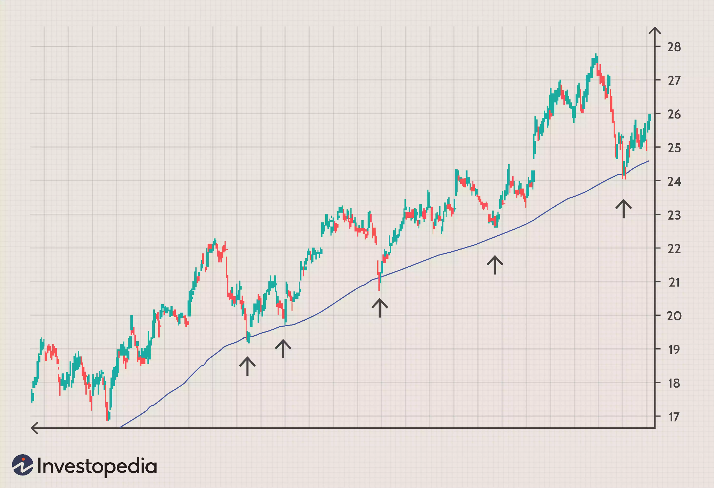
Dual Simple Moving Average (SMA) Crossover Strategy - 2
In an uptrend sma-slow acts as a support/floor
In downtrend sma-slow acts as a resistance/ceiling
Helps to understand price movement for buy sell decisions.
Cons:
Does not take the fundamentals into account
Based on the historicals - no future prediction
Price action is choppy
https://www.investopedia.com/articles/active-trading/052014/how-use-moving-average-buy-stocks.asp

Slide 6
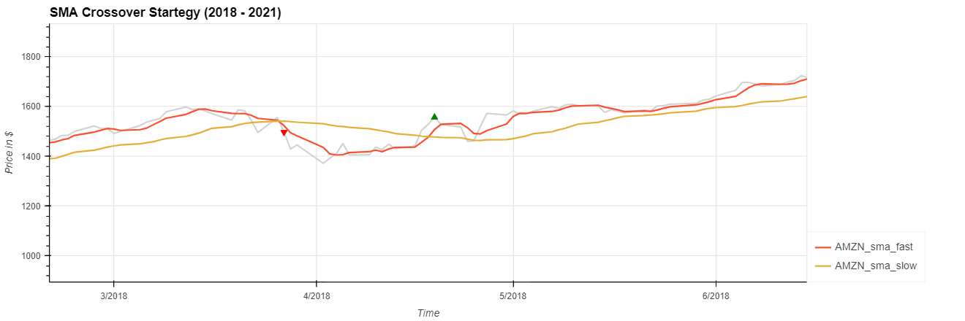
Dual Simple Moving Average (SMA) Crossover Strategy - 3
Crossover point where sma-fast > sma-slow: buy signal (Golden Cross)
Crossover point where sma-fast < sma-slow: sell signal (Death Cross)
Downtrend Ceiling
Uptrend Floor

Slide 7
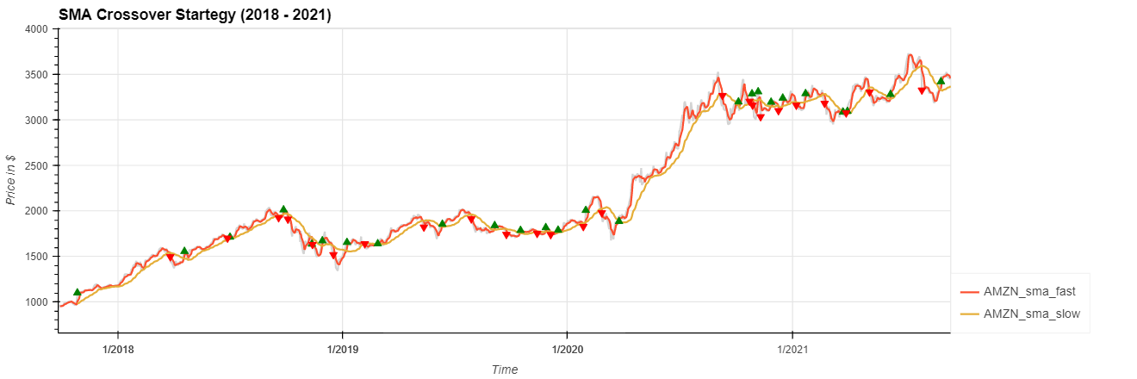
Case Study AMZN - Price of Security
Long-term, Entry: green-tick, Exit: red-tick, AMZN Security: Gray

Slide 8
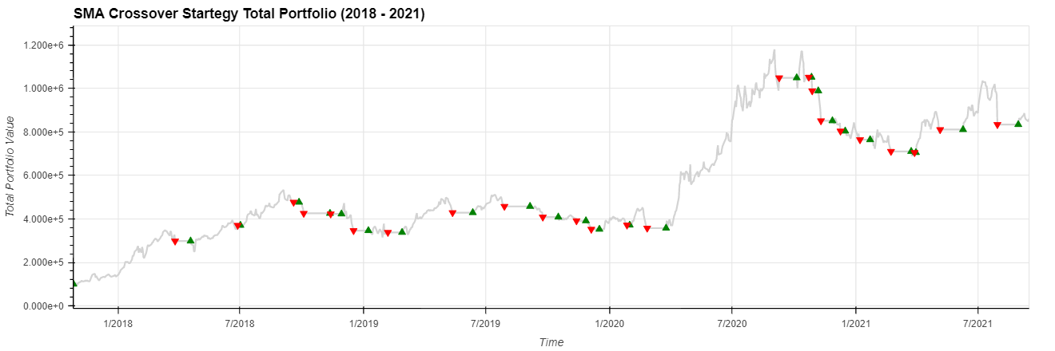
Case Study AMZN - Total Portfolio
Flat: cash holdings - out of market, Entry: green-tick, Exit: red-tick

Slide 9


Case Study AMZN - SMA - Metrics
Metric | Backtest
Annual Return | 68.18%
Cumulative Returns (times = ×) | 7.61
Annual Volatility | 50.23
Sharpe Ratio | 1.36
Sortino Ratio | 2.07
Very Good | Good | Sub-Optimal
Sharpe > 2 | 2 > Sharpe > 1 | 1 > Sharpe
Sortino > 2 | 2 > Sortino > 1 | 1 > Sortino
Strategy didn’t remove volatility - inherent in AMZN; Other metrics: behaved favorably.
Notes:
Sharpe = risk adjusted return. Return over Risk Free (10-yr T-note) Rate divided by the STD of the security
Sortino = a better measurement of risk adjusted return as it considers only the down side risk.

Slide 10
Dual Exponentially weighted Moving Average (EWM) Crossover Strategy - 1
Pros:
A well used Technical Analysis tool.
Many variations are possible.
Weighs close events higher comparatively, thus in general better for volatile securities.
Our selection
(set day-average values low as tech stocks have a high volatility)
Daily OHLC from Alpaca API. We have chosen daily closing price of the equity.
4-day average of the daily closing price = ewm-fast
24-day average of the daily closing price = ewm-slow

Slide 11
Dual Exponentially weighted Moving Average (EWM) Crossover Strategy - 2
Crossover point where ewm-fast > ewm-slow: buy signal (Golden Cross)
Crossover point where ewm-fast < ewm-slow: sell signal (Death Cross)
In an uptrend ewm-slow acts as a support/floor
In downtrend ewm-slow acts as a resistance/ceiling
Helps to understand price movement for buy sell decisions.
Cons:
Does not take the fundamentals into account
Based on the historicals - no future prediction
Behaves well in strong trading conditions (bull markets) not so when ranging. Changing the intervals may help.

Slide 12
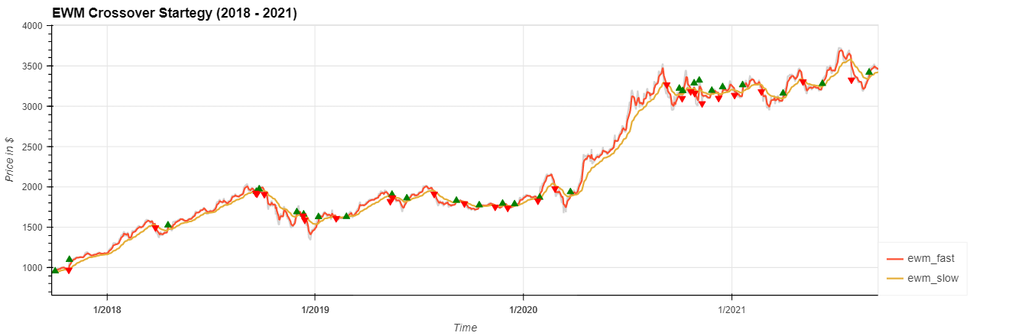
Case Study AMZN - Price of Security
Long-term, Entry: green-tick, Exit: red-tick, AMZN Security: Gray

Slide 13
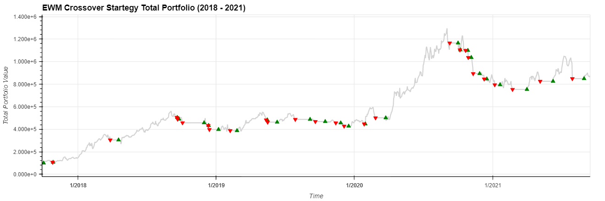
Case Study AMZN - Total Portfolio
Flat: cash holdings - out of market, Entry: red-tick, Exit: green-tick,

Slide 14
Case Study AMZN - EWM - Metrics
Metric | Backtest
Annual Return | 65.62%
Cumulative Returns (times = ×) | 7.76
Annual Volatility | 46.24
Sharpe Ratio | 1.41
Sortino Ratio | 2.17
Very Good | Good | Sub-Optimal
Sharpe > 2 | 2 > Sharpe > 1 | 1 > Sharpe
Sortino > 2 | 2 > Sortino > 1 | 1 > Sortino
Strategy didn’t remove volatility - inherent in AMZN; Other metrics: behaved favorably.

Slide 15
Comparison - Crossover Average Strategies
Metric - SMA | Backtest
Annual Return | 68.18%
Cumulative Returns (times = ×) | 7.61
Annual Volatility | 50.23
Sharpe Ratio | 1.36
Sortino Ratio | 2.07
Metric - EWM | Backtest
Annual Return | 65.62%
Cumulative Returns (times = ×) | 7.76
Annual Volatility | 46.24
Sharpe Ratio | 1.41
Sortino Ratio | 2.17
EWM - reduce annual return, increase cumulative returns, decreased volatility, increased Sharpe ratio, increased Sortino ratio, more transactions (23 to 25, not shown) i.e., could be costly.
Bottomline: EWM Crossover Strategy is marginally superior.

Slide 16
Algorithmic Trading Analysis using a combination of two Trading Indicators:
Stochastic Oscillator and Simple Moving Averages
Stochastic Oscillator is a momentum-based leading indicator that is widely used to identify whether the market is in the state of overbought or oversold. Features:
Always lies between 0 to 100 due to its normalization function
In General, Overbought level is 80, and Oversold level is 20
comprises two main components:
%K Line: a.k.a. the Fast Stochastic indicator
The sole purpose of this line is to express the current state of the market (overbought or oversold); Standard setting is 14 as the number of periods.
%K Line = 100 * ((Today's CLOSING PRICE - k_period LOWEST PRICE) / (k_period HIGHEST PRICE - k_period LOWEST PRICE))
%D Line: a.k.a. the Slow Stochastic indicator
This is defined as the moving average (smooth version) of the %K line for a specified period; Standard setting is 3 as the number of periods.

Slide 17
Process Summary of the Analysis
Create Stochastic Oscillator Model
Add Simple Moving Average Trading Indicators
Run the model and perform Backtesting
Run Parameter Sweep for the combined Model
Refine The model
Define %K Line number of periods
Calculate K Line
Define %D Line number of Periods
Calculate %D Line
Create Trading Signals
IF %K LINE < 20 AND %D LINE < 20 AND %K LINE < %D LINE => BUY
IF %K LINE > 80 AND %D LINE > 80 AND %K LINE > %D LINE => SELL
Define Short Window and Calculate Fast Indicator
Define Long Window and Calculate Slow Indicator
Combine signals for Stochastic Oscillator, and Simple Moving Average using 'OR' operator
Run Backtesting to generate the following for model evaluation:
Annual Returns
Cumulative Returns
Annualized Volatility
Sharpe Ratio
Sortino Ratio
For each combination of Parameters for the two models, run the full Trading Analysis and Backtesting to find out the Param Set which has the best Sharpe Ratio, and Cumulative Returns
Refine the model using the Param set determined by the Param sweep exercise

Slide 18
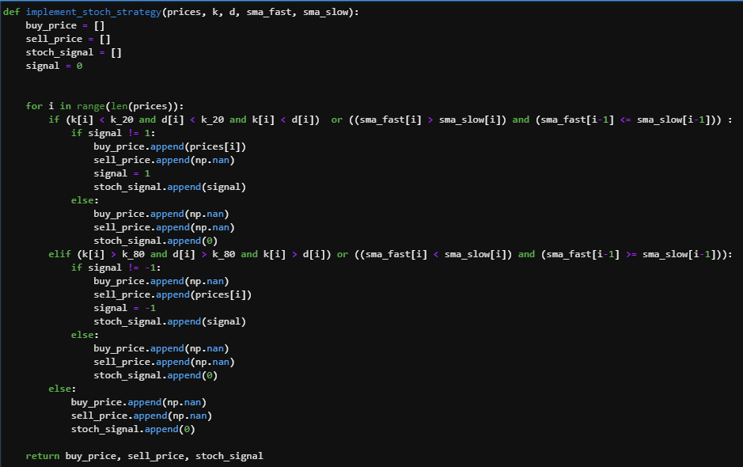
A deeper look into the two key parts of the Analysis
Combination of two Trading Indicators

Slide 19
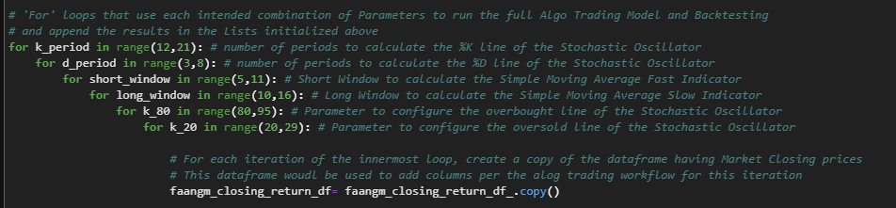
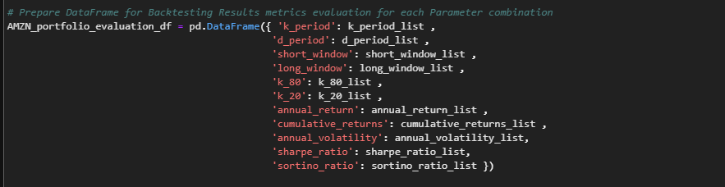
Parameter Sweep for Algorithmic Trading Analyser that uses a combination of two Trading Indicators: Stochastic Oscillator and Simple Moving Averages

Slide 20
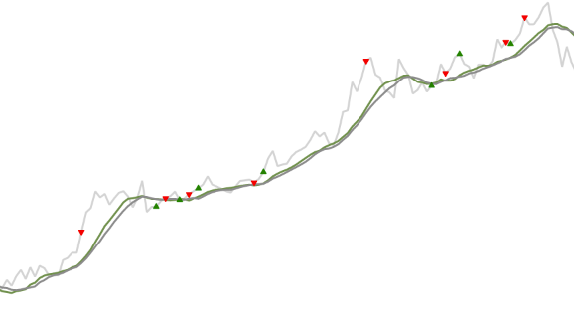
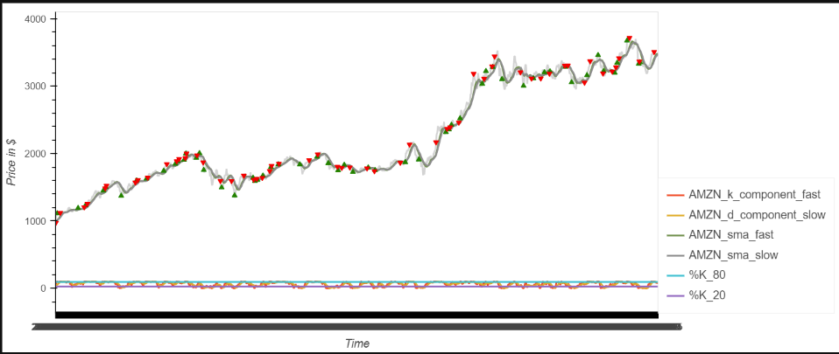
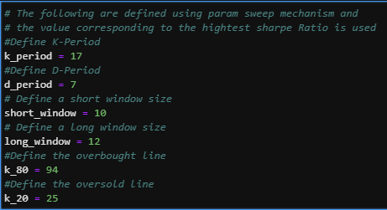
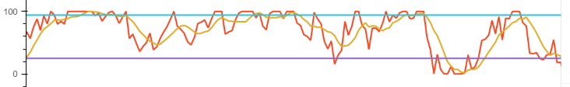
Trading Indicators, Signals and Entry/Exit

Slide 21
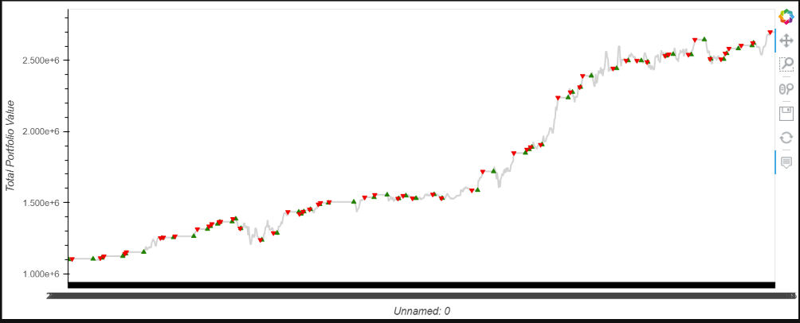
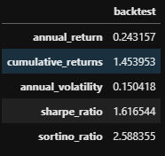
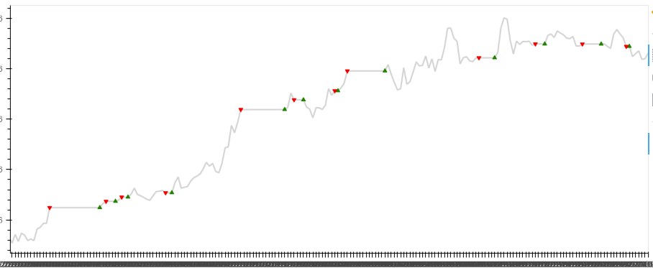
Portfolio Growth with Initial Capital of $1.1Mn and Share size of 500 & Backtesting

Slide 22
ML Models Used
Support Vector Machine
Random Forest
Gradient Boosting

Slide 23
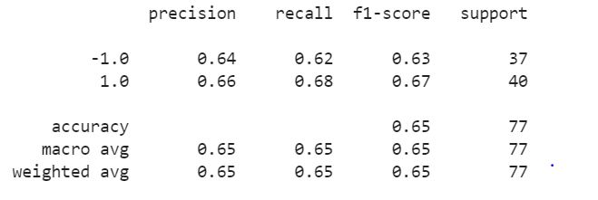
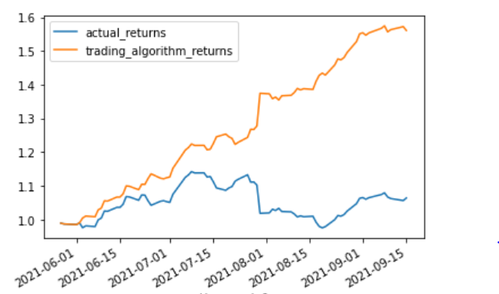
ML Models -SVM

Slide 24
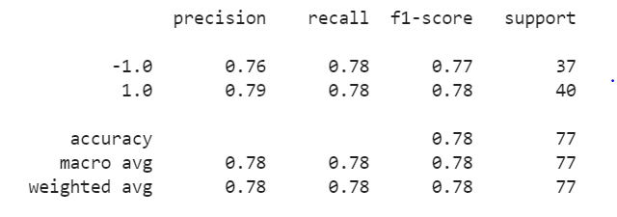
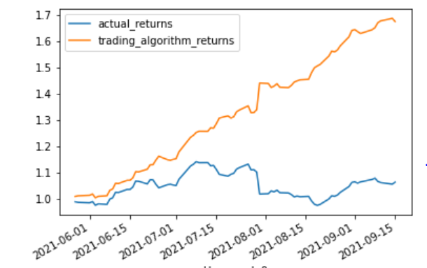
ML Models -RF

Slide 25
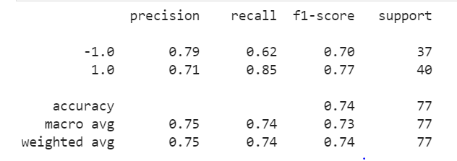
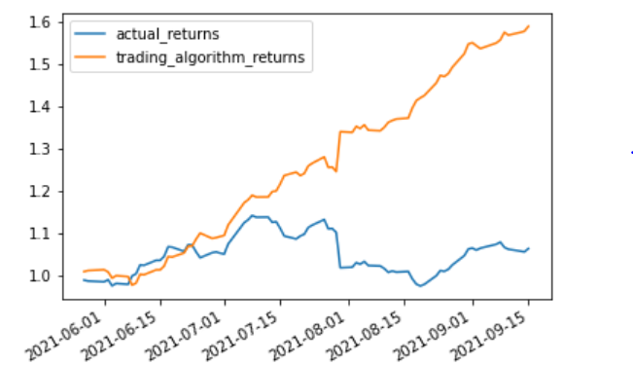
ML Models -Gradient Boosting

Slide 26
Summary
We have selected a volatile tech stock, Amazon Inc. (AMZN) and implemented multiple Algorithmic Trading strategies:
Dual SMA (Simple Moving Average) crossover strategy
Dual EWM (Exponentially Weighted Moving Average) crossover strategy - Best Cumulative return
Stochastic Oscillator and Simple Moving Average combination strategy with param sweep - Best Sharpe Ratio/Sortino Ratio
Support Vector Machine (SVM), Random Forests (RF), and Gradient Boosting (GB) ML implementation strategies - RF behaves better comparatively as shown by the Classification Report.
There are pros - cons in these strategies and each strategy should be so selected for the conditions at hand.

Slide 27
Postmortem
Disclosure: some of the members own AMZN
Some implementations require selective decision making upon observing a metric: case in point when we attempt to implement Relative Strength Index (RSI) as the movements of index would result in sequential buy signals or sequential sell signals where a user selects the point of entry or exit from the index.
Parameter Sweep Exercise is costly from computation perspective. A high end GPU processor, mostly could based (AWS Sagemaker/Google Colab) could help to reduce the execution time.
Future Studies can be done to improve the two trading indicator model by adding a third one, most likely Relative Strength Index (RSI), and an ability to pre-smooth the curve.

Slide 28
Bibliography
Stochastic Oscillator:
https://medium.com/codex/algorithmic-trading-with-stochastic-oscillator-in-python-7e2bec49b60d
https://www.metastock.com/customer/resources/taaz/?p=106
Dual Crossover SMA
https://www.investopedia.com/articles/active-trading/052014/how-use-moving-average-buy-stocks.asp
Dual Crossover EWM
https://www.statology.org/exponential-moving-average-pandas/
https://pandas.pydata.org/pandas-docs/stable/reference/api/pandas.DataFrame.ewm.html
Sharpe Ratio
https://www.investopedia.com/terms/s/sharperatio.asp
Sortino Ratio
https://www.investopedia.com/terms/s/sortinoratio.asp
https://therobusttrader.com/sortino-ratio/

